Slide 1
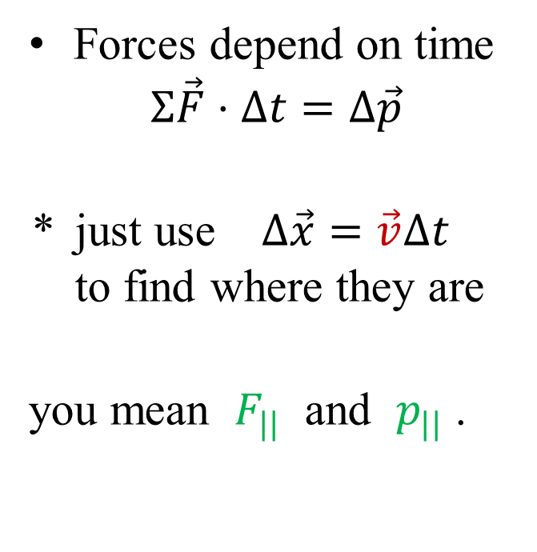
Unit 2 overview
Newton
Leibniz
Forces depend on time
$$Σ\vec{F}⋅Δt=Δ\vec{p}$$
* just use $Δ\vec{x}=\vec{v}Δt$ to find where they are
you mean $F_{||}$ and $p_{||}$ .
most Forces depend on place
vectors are a pain to use $Σ\vec{F}⋅ {\vec{v}}_{avg} Δt=Δ\vec{p}⋅{\vec{v}}_{avg}$
⇒ $Σ\vec{F}⋅Δ\vec{x}=Δ\vec{p}⋅{\vec{v}}_{avg}$

Slide 2
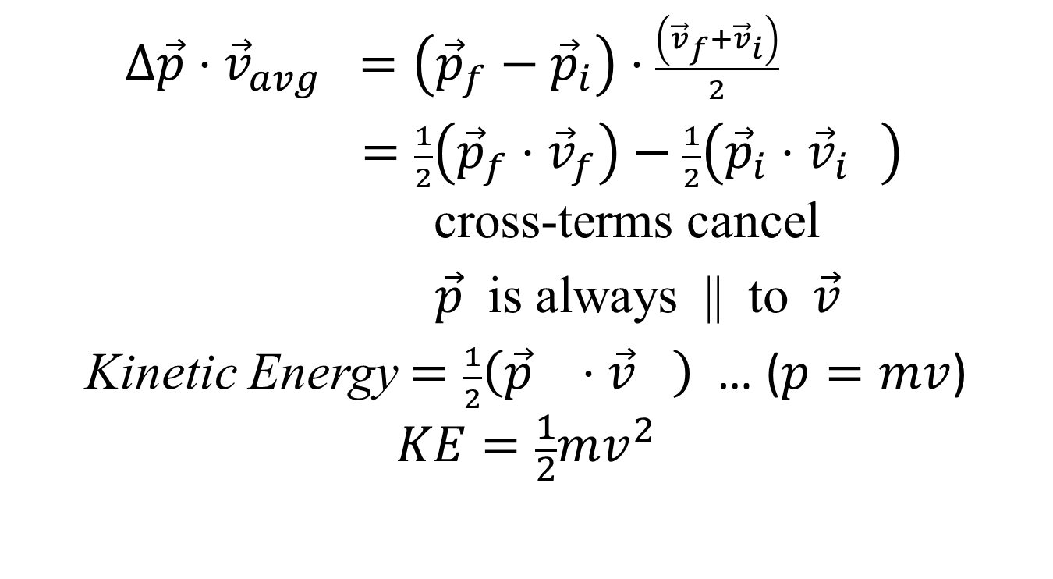
Effect is a scalar
$Δ\vec{p}⋅{\vec{v}}_{avg} =\left({\vec{p}}_{f}−{\vec{p}}_{i}\right)⋅\frac{\left({\vec{v}}_{f}+{\vec{v}}_{i}\right)}{2}$
$=\frac{1}{2}\left({\vec{p}}_{f}⋅{\vec{v}}_{f}\right)−\frac{1}{2}\left({\vec{p}}_{i}⋅{\vec{v}}_{i_{}}\right)$ cross-terms cancel
$\vec{p}$ is always || to $\vec{v}$
Kinetic Energy $=\frac{1}{2}\left({\vec{p}}_{}⋅{\vec{v}}_{}\right)$ … ($p=mv$)
$$KE=\frac{1}{2}mv^{2}$$

Slide 3
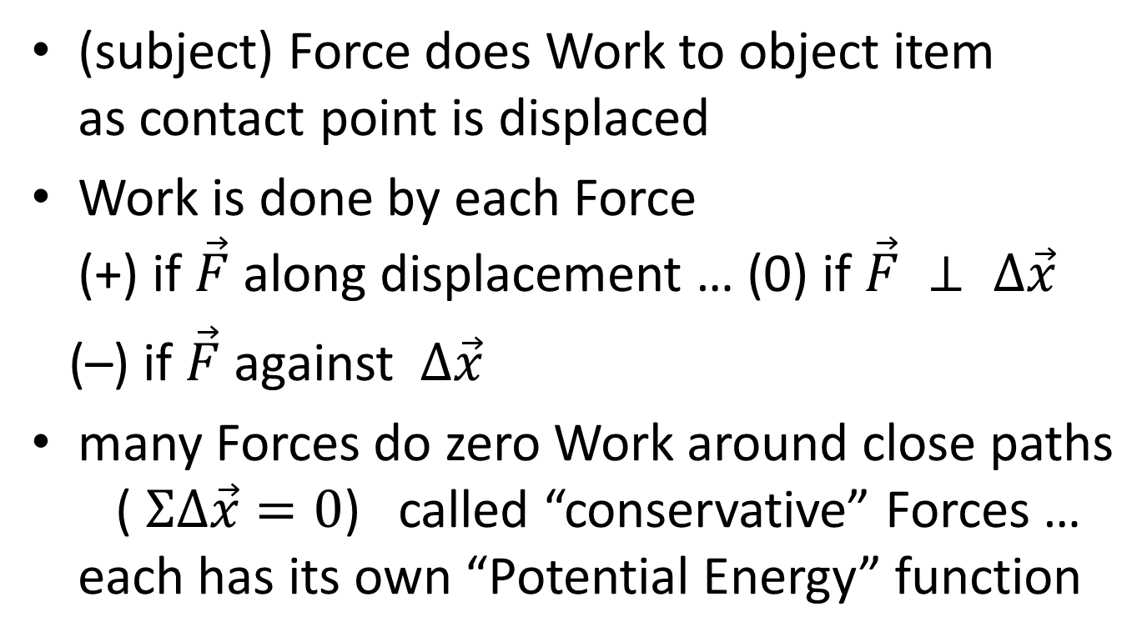
$ΣW$ causes $KE$ change
(subject) Force does Work to object item as contact point is displaced
Work is done by each Force (+) if $\vec{F}$along displacement … (0) if $\vec{F} ⊥ Δ\vec{x}$
(–) if $\vec{F}$against $Δ\vec{x}$
many Forces do zero Work around close paths ( $ΣΔ\vec{x}=0$) called “conservative” Forces … each has its own “Potential Energy” function

Slide 4

Potential Energy functions
local gravity ($m\vec{g}$) …
pressure ($P\vec{A}$) …
elastic springs ($−k\vec{s}$) …
planet gravity ($m\frac{GM}{r^{2}}$) …

